Slide 1
Guessing Number Game
T1A3- Terminal App
Fabian Perre
Student 14333
Using Python

Slide 2
overview
Use of python3 and its packages
Csv
Colored
Prettytable
Random
time
from random import *
import csv
import time
from colored import fg, bg, attr
from prettytable import from_csv

Slide 3
Features
User inputs name and age
Main Game
Three Rounds
Three guesses per round
Each round gets harder
The range depends on age of user
Challenge Game
List of numbers to pick
Program picks a random secret number
Timed game, each game is different between 5 -12 seconds
User needs to guess the number
List of results
All results can be viewed in a neat table

Slide 4
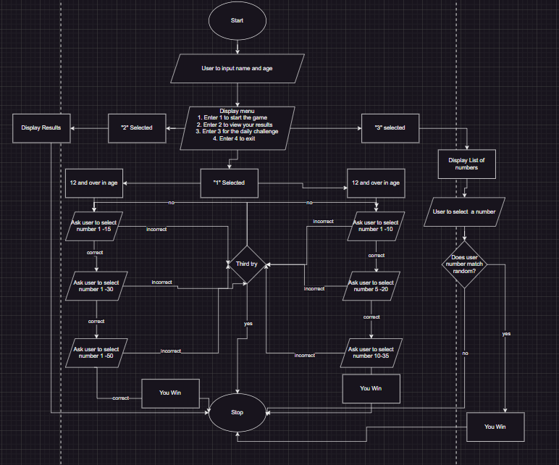
flowchart

Slide 5
Variables
guess_attempts_r1 = 3
guess_attempts_r2 = 3
guess_attempts_r3 = 3
# Produces random number
actual_number_r1 = randint(1, 15)
actual_number_r2 = randint(1, 30)
actual_number_r3 = randint(1, 50)
# Sets results to False, changes to true when round passed
result_r1 = False
result_r2 = False
result_r3 = False

Slide 6
Loop
while guess_attempts_r1 > 0:
# print(actual_number_r1) # Uncomment for testing
while True:
try:
guess = int(input(f'{bg(127)}Enter your guess between 1-15:{attr(0)}' ))
break
except ValueError as e:
print('Not a number, Try again')
except Exception:
print('Try again')
if guess != actual_number_r1:
print("Incorrect")
guess_attempts_r1 -= 1
print(f"Remaining attempts: {guess_attempts_r1}")
else:
print("You guessed correctly. Move to the next round")
result_r1 = True
break

Slide 7
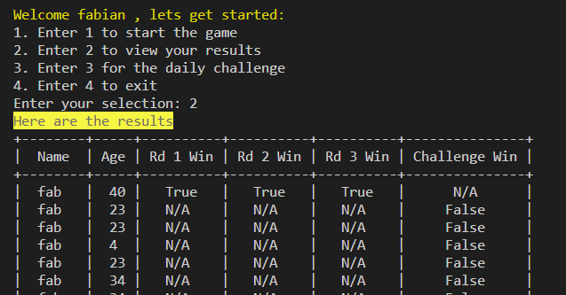
Results
All results are listed in results.csv
When users guess correct variable is changed to True and printed in csv file
This can be viewed by pressing ‘2’ on the menu
Notes:
source game-venv/bin/activate

